Slide 1
Introduction to DATA Mining & Data visualization

Slide 2
What is data mining?
Data mining is the process of sorting through large data sets to identify patterns and relationships that can help solve business problems through data analysis.
It helps in:
Planning business strategies
Making informed decisions
Manage operations etc.

Slide 3
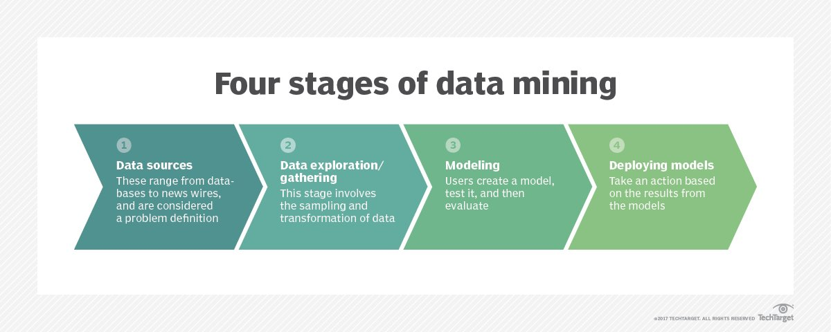
data mining process
Data gathering - Different source systems, a data warehouse, mix of structured and unstructured data
Data preparation - Data exploration, profiling and pre-processing, data cleansing
Mining the data – Choose appropriate data mining technique and then implement one or more algorithms
Data analysis and interpretation - data mining results are used to create analytical models that can help drive decision-making and other business actions

Slide 4
Types of data mining techniques – Page1
Descriptive Modeling: It uncovers shared similarities or groupings in historical data to determine reasons behind success or failure, such as categorizing customers by product preferences or sentiment. Sample techniques include:
Clustering | Grouping similar records together.
Anomaly detection | Identifying multidimensional outliers.
Association rule learning | Detecting relationships between records.
Principal component analysis | Detecting relationships between variables.
Affinity grouping | Grouping people with common interests or similar goals (e.g., people who buy X often buy Y and possibly Z).

Slide 5
Types of data mining techniques – Page2
Predictive Modeling: This modeling goes deeper to classify events in the future or estimate unknown outcomes. Sample techniques include:
Regression | A measure of the strength of the relationship between one dependent variable and a series of independent variables.
Neural Networks | Computer programs that detect patterns, make predictions and learn.
Decision trees | Tree-shaped diagrams in which each branch represents a probable occurrence.
Support vector machines | Supervised learning models with associated learning algorithms.

Slide 6
Types of data mining techniques – Page3
Prescriptive modelling: looks at internal and external variables and constraints to recommend one or more courses of action – for example, determining the best marketing offer to send to each customer. Sample techniques include:
Predictive analytics plus rules | Developing if/then rules from patterns and predicting outcomes.
Marketing optimization | Simulating the most advantageous media mix in real time for the highest possible ROI.

Slide 7
DATA VisualizatioN
Graphics and visuals, if used intelligently and innovatively, can convey a lot more than what raw data alone can convey. Some examples:
Cricket ODI Batting
India Budget History
Software ecosystem
List of a few python libraries used for Data Visualization
Matplotlib | geoplotlib
Seaborn | Gleam
Plotnine(ggplot) | missingno
Bokeh | Leather
pygal | Altair
Plotly | Folium

Slide 8
Data set – pls load them into jupyter notebook

